Slide 1
Fake News Detection
Lanqing Zhao
Zhiwei Tan

Slide 2
Executive Summary
Objective develop an algorithm capable of determining whether a news article is fake or real. Trained on 44,898 entries with 121,107 features. Best model determined to be linear support vector machines
LinearSVC:
True Negative (TN), True Positive (TP),
False Negative (FN), False Positive (FP)
Accuracy (TN + TP) / (TN + FN +TP +FP) :
98.750%
Precision TP / (TP +FP) :
Fake News: 99.36% True News: 98.753%
Recall TP / (TP + FN):
Fake News: 99.23% True News: 98.742%
F1 Score 2*((Precision * Recall) / (Precision + Recall)):
98.748%

Slide 3
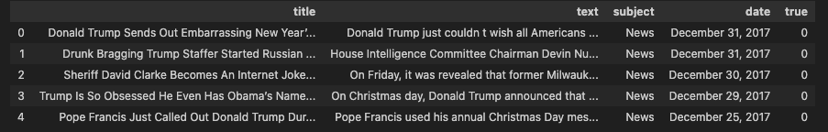
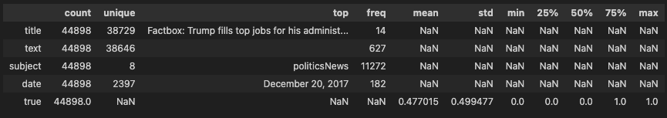
Data Frame
Entries
1485 Characters
275 words

Slide 4
Text Sample
True Story:
Original text
WASHINGTON (Reuters) - Transgender people will be allowed for the first time to enlist in the U.S. military starting on Monday as ordered by federal courts, the Pentagon said on Friday, after President Donald Trump’s administration decided not to appeal rulings that blocked his transgender ban. Two federal appeals courts, one in Washington and one in Virginia, last week rejected the administration’s request to put on hold orders by lower court judges requiring the military to begin accepting transgender recruits on Jan. 1. A Justice Department official said the administration will not challenge those rulings. “The Department of Defense has announced that it will be releasing an independent study of these issues in the coming weeks. So rather than litigate this interim appeal before that occurs, the administration has decided to wait for DOD’s study and will continue to defend the president’s lawful authority in District Court in the meantime,” the official said, speaking on condition of anonymity. In September, the Pentagon said it had created a panel of senior officials to study how to implement a directive by Trump to prohibit transgender individuals from serving. The Defense Department has until Feb. 21 to submit a plan to Trump. Lawyers representing currently-serving transgender service members and aspiring recruits said they had expected the administration to appeal the rulings to the conservative-majority Supreme Court, but were hoping that would not happen.
Pentagon spokeswoman Heather Babb said in a statement: “As mandated by court order, the Department of Defense is prepared to begin accessing transgender applicants for military service Jan. 1. All applicants must meet all accession standards.” Jennifer Levi, a lawyer with gay, lesbian and transgender advocacy group GLAD, called the decision not to appeal “great news.” “I’m hoping it means the government has come to see that there is no way to justify a ban and that it’s not good for the military or our country,” Levi said. Both GLAD and the American Civil Liberties Union represent plaintiffs in the lawsuits filed against the administration. In a move that appealed to his hard-line conservative supporters, Trump announced in July that he would prohibit transgender people from serving in the military, reversing Democratic President Barack Obama’s policy of accepting them. Trump said on Twitter at the time that the military “cannot be burdened with the tremendous medical costs and disruption that transgender in the military would entail.” Four federal judges - in Baltimore, Washington, D.C., Seattle and Riverside, California - have issued rulings blocking Trump’s ban while legal challenges to the Republican president’s policy proceed. The judges said the ban would likely violate the right under the U.S. Constitution to equal protection under the law. The Pentagon on Dec. 8 issued guidelines to recruitment personnel in order to enlist transgender applicants by Jan. 1.
The memo outlined medical requirements and specified how the applicants’ sex would be identified and even which undergarments they would wear. The Trump administration previously said in legal papers that the armed forces were not prepared to train thousands of personnel on the medical standards needed to process transgender applicants and might have to accept “some individuals who are not medically fit for service.” The Obama administration had set a deadline of July 1, 2017, to begin accepting transgender recruits. But Trump’s defense secretary, James Mattis, postponed that date to Jan.
1, 2018, which the president’s ban then put off indefinitely. Trump has taken other steps aimed at rolling back transgender rights. In October, his administration said a federal law banning gender-based workplace discrimination does not protect transgender employees, reversing another Obama-era position. In February, Trump rescinded guidance issued by the Obama administration saying that public schools should allow transgender students to use the restroom that corresponds to their gender identity.

Slide 5
Text Sample
Cleaned text
transgender people will be allowed for the first time to enlist in the us military starting on monday as ordered by federal courts the pentagon said on friday after president donald trumps administration decided not to appeal rulings that blocked his transgender ban two federal appeals courts one in washington and one in virginia last week rejected the administrations request to put on hold orders by lower court judges requiring the military to begin accepting transgender recruits on jan 1 a justice department official said the administration will not challenge those rulings the department of defense has announced that it will be releasing an independent study of these issues in the coming weeks so rather than litigate this interim appeal before that occurs the administration has decided to wait for dods study and will continue to defend the presidents lawful authority in district court in the meantime the official said speaking on condition of anonymity in september the pentagon said it had created a panel of senior officials to study how to implement a directive by trump to prohibit transgender individuals from serving the defense department has until feb 21 to submit a plan to trump lawyers representing currently-serving transgender service members and aspiring recruits said they had expected the administration to appeal the rulings to the conservative-majority supreme court but were hoping that would not happen pentagon spokeswoman heather babb said in a statement as mandated by court order the department of defense is prepared to begin accessing transgender applicants for military service jan 1 all applicants must meet all accession standards jennifer levi a lawyer with gay lesbian and transgender advocacy group glad called the decision not to appeal great news im hoping it means the government has come to see that there is no way to justify a ban and that its not good for the military or our country levi said both glad and the american civil liberties union represent plaintiffs in the lawsuits filed against the administration in a move that appealed to his hard-line conservative supporters trump announced in july that he would prohibit transgender people from serving in the military reversing democratic president barack obamas policy of accepting them trump said on twitter at the time that the military cannot be burdened with the tremendous medical costs and disruption that transgender in the military would entail four federal judges - in baltimore washington dc seattle and riverside california - have issued rulings blocking trumps ban while legal challenges to the republican presidents policy proceed the judges said the ban would likely violate the right under the us constitution to equal protection under the law the pentagon on dec 8 issued guidelines to recruitment personnel in order to enlist transgender applicants by jan 1 the memo outlined medical requirements and specified how the applicants sex would be identified and even which undergarments they would wear the trump administration previously said in legal papers that the armed forces were not prepared to train thousands of personnel on the medical standards needed to process transgender applicants and might have to accept some individuals who are not medically fit for service the obama administration had set a deadline of july 1 2017 to begin accepting transgender recruits but trumps defense secretary james mattis postponed that date to jan 1 2018 which the presidents ban then put off indefinitely trump has taken other steps aimed at rolling back transgender rights in october his administration said a federal law banning gender-based workplace discrimination does not protect transgender employees reversing another obama-era position in february trump rescinded guidance issued by the obama administration saying that public schools should allow transgender students to use the restroom that corresponds to their gender identity
Sample Character length:
4077

Slide 6
Text Sample
Fake Story:
Original text
On Christmas day, Donald Trump announced that he would be back to work the following day, but he is golfing for the fourth day in a row. The former reality show star blasted former President Barack Obama for playing golf and now Trump is on track to outpace the number of golf games his predecessor played.Updated my tracker of Trump s appearances at Trump properties.71 rounds of golf including today s. At this pace, he ll pass Obama s first-term total by July 24 next year. https://t.co/Fg7VacxRtJ pic.twitter.com/5gEMcjQTbH Philip Bump (@pbump) December 29, 2017 That makes what a Washington Post reporter discovered on Trump s website really weird, but everything about this administration is bizarre AF. The coding contained a reference to Obama and golf: Unlike Obama, we are working to fix the problem and not on the golf course. However, the coding wasn t done correctly.The website of Donald Trump, who has spent several days in a row at the golf course, is coded to serve up the following message in the event of an internal server error: https://t.co/zrWpyMXRcz pic.twitter.com/wiQSQNNzw0 Christopher Ingraham (@_cingraham) December 28, 2017That snippet of code appears to be on all https://t.co/dkhw0AlHB4 pages, which the footer says is paid for by the RNC? pic.twitter.com/oaZDT126B3 Christopher Ingraham (@_cingraham) December 28, 2017It s also all over https://t.co/ayBlGmk65Z. As others have noted in this thread, this is weird code and it s not clear it would ever actually display, but who knows. Christopher Ingraham (@_cingraham) December 28, 2017After the coding was called out, the reference to Obama was deleted.UPDATE: The golf error message has been removed from the Trump and GOP websites. They also fixed the javascript = vs == problem. Still not clear when these messages would actually display, since the actual 404 (and presumably 500) page displays a different message pic.twitter.com/Z7dmyQ5smy Christopher Ingraham (@_cingraham) December 29, 2017That suggests someone at either RNC or the Trump admin is sensitive enough to Trump s golf problem to make this issue go away quickly once people noticed. You have no idea how much I d love to see the email exchange that led us here. Christopher Ingraham (@_cingraham) December 29, 2017 The code was f-cked up.The best part about this is that they are using the = (assignment) operator which means that bit of code will never get run. If you look a few lines up errorCode will always be 404 (@tw1trsux) December 28, 2017trump s coders can t code. Nobody is surprised. Tim Peterson (@timrpeterson) December 28, 2017Donald Trump is obsessed with Obama that his name was even in the coding of his website while he played golf again.Photo by Joe Raedle/Getty Images.

Slide 7
Text Sample
Cleaned text
on christmas day donald trump announced that he would be back to work the following day but he is golfing for the fourth day in a row the former reality show star blasted former president barack obama for playing golf and now trump is on track to outpace the number of golf games his predecessor playedupdated my tracker of trump s appearances at trump properties71 rounds of golf including today s at this pace he ll pass obama s first-term total by july 24 next year philip bump december 29 2017 that makes what a washington post reporter discovered on trump s website really weird but everything about this administration is bizarre af the coding contained a reference to obama and golf unlike obama we are working to fix the problem and not on the golf course however the coding wasn t done correctlythe website of donald trump who has spent several days in a row at the golf course is coded to serve up the following message in the event of an internal server error christopher ingraham december 28 2017 that snippet of code appears to be on all pages which the footer says is paid for by the rnc christopher ingraham december 28 2017 it s also all over as others have noted in this thread this is weird code and it s not clear it would ever actually display but who knows christopher ingraham december 28 2017 after the coding was called out the reference to obama was deletedupdate the golf error message has been removed from the trump and gop websites they also fixed the javascript vs problem still not clear when these messages would actually display since the actual 404 and presumably 500 page displays a different message christopher ingraham december 29 2017 that suggests someone at either rnc or the trump admin is sensitive enough to trump s golf problem to make this issue go away quickly once people noticed you have no idea how much i d love to see the email exchange that led us here christopher ingraham december 29 2017 the code was f-cked upthe best part about this is that they are using the assignment operator which means that bit of code will never get run if you look a few lines up errorcode will always be 404 december 28 2017 trump s coders can t code nobody is surprised tim peterson december 28 2017 donald trump is obsessed with obama that his name was even in the coding of his website while he played golf againphoto by joe raedlegetty images
Sample Character length:
2774

Slide 8
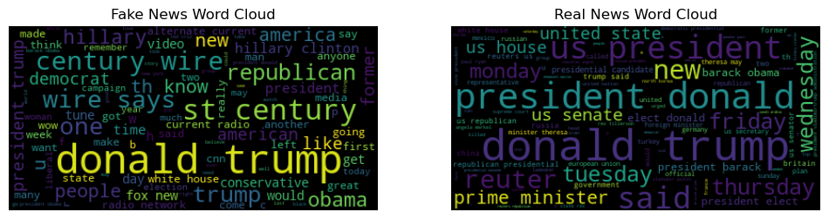
Word Cloud
Top 100 frequent words fake news entries
Top 100 frequent words real news entries

Slide 9
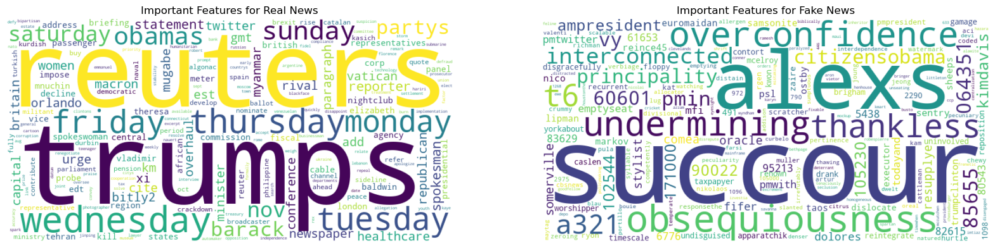
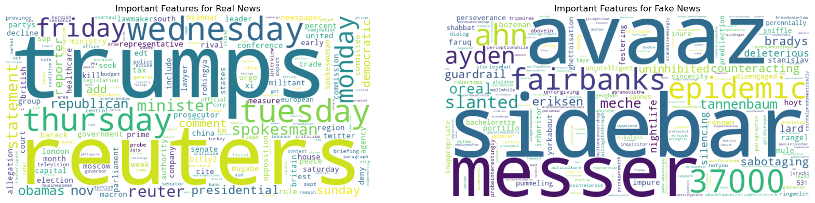
Word Cloud Logistic Regression
Count
TFID
Top words of a sample real news entry
Top words of a sample fake news entry

Slide 10
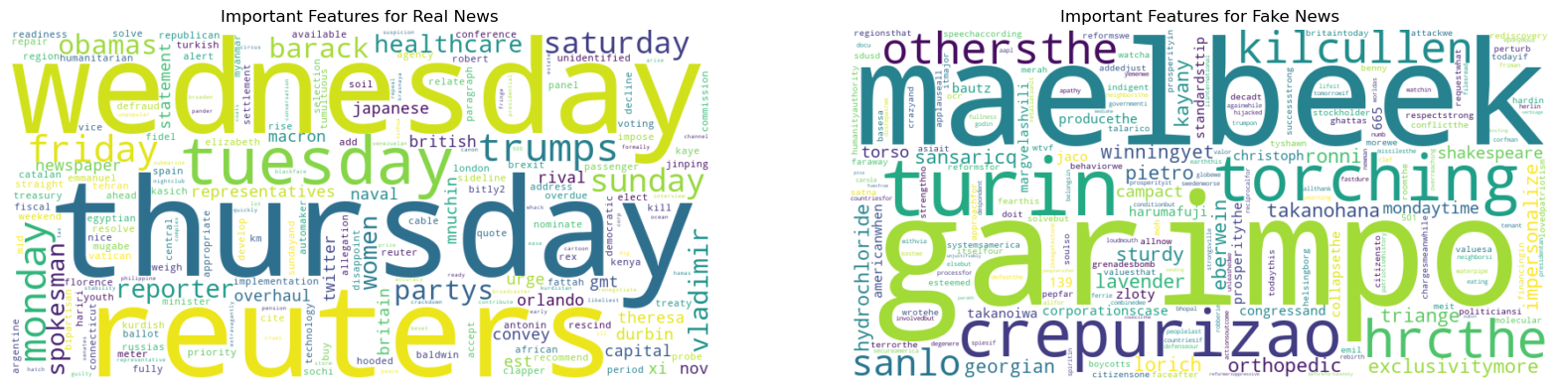

Word Cloud Linear SVM
Count
TFID
Top words of a sample real news entry
Top words of a sample fake news entry

Slide 11
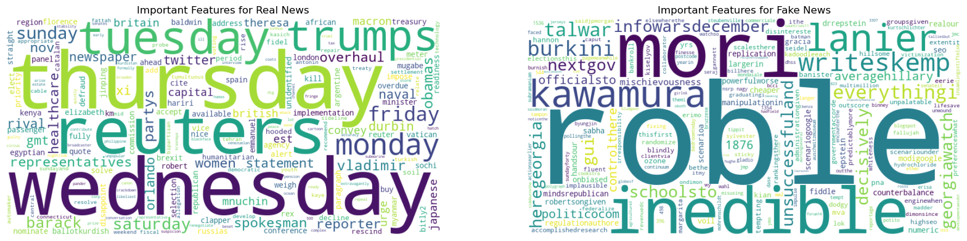
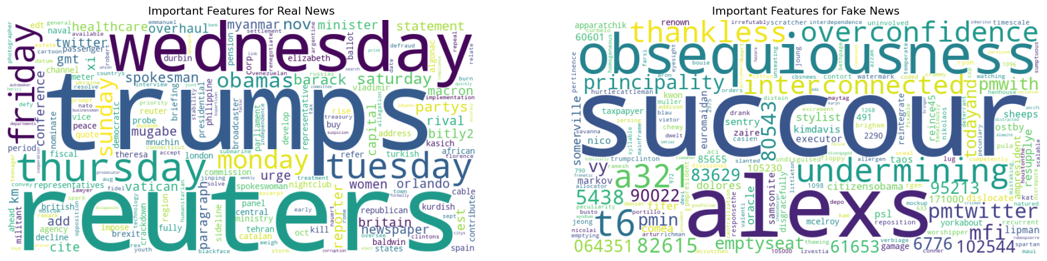
Word Cloud SVM
Count
TFID
Top words of a sample real news entry
Top words of a sample fake news entry

Slide 12
Data Acquisition
Data was acquired from the following warehouses and tables:
GitHub
https://github.com/emmanueliarussi/DataScienceCapstone/tree/master/3_MidtermProjects/ProjectFN
Kaggle
Kaggle
https://www.kaggle.com/datasets/clmentbisaillon/fake-and-real-news-dataset

Slide 13
Data Preparation
Data was assessed and prepared with the following criteria:
Identification and removal of missing values
Drop 'title’, ’subject’, 'date’
Drop nan
Reshuffle the data
Transformations
Remove links, non-alphanumeric characters, normalize case
Lemmatization
CountVectorizer Vectorization
TfidfVectorizer Vectorization
Partitioning
Train Test splits

Slide 14
Count Vectorizer
The Count Vectorizer is a text vectorization technique that converts a collection of text documents into a matrix of token counts.
It creates a vocabulary of all unique words in the corpus.
Each document is then represented as a vector where each element represents the count of a word in that document.
It's useful when the frequency of words is an important feature for the model.

Slide 15
TF-IDF Vectorizer
The TF-IDF (Term Frequency-Inverse Document Frequency) Vectorizer transforms text documents into vectors based on the importance of each word in the document and across all documents in the corpus.
TF: Measures the frequency of a term in a document.
IDF: Measures how important a term is in the entire corpus. It is calculated as the logarithm of the total number of documents divided by the number of documents containing the term.
The TF-IDF score for a term is the product of its TF and IDF scores.

Slide 16
Model Selection
Data requirements allowed the following algorithms to be considered:
Naive Bayes
Logistic Regression
Support Vector Machine (SVM)
K-Nearest Neighbor (KNN)
Random Forest

Slide 17
Model Selection
The optimal tuning was found for each of the above algorithms using an exhaustive grid search resulting in the calculated evaluation metrics:

Slide 18
Model Selection
The optimal tuning was found for each of the above algorithms using an exhaustive grid search resulting in the calculated evaluation metrics:

Slide 19
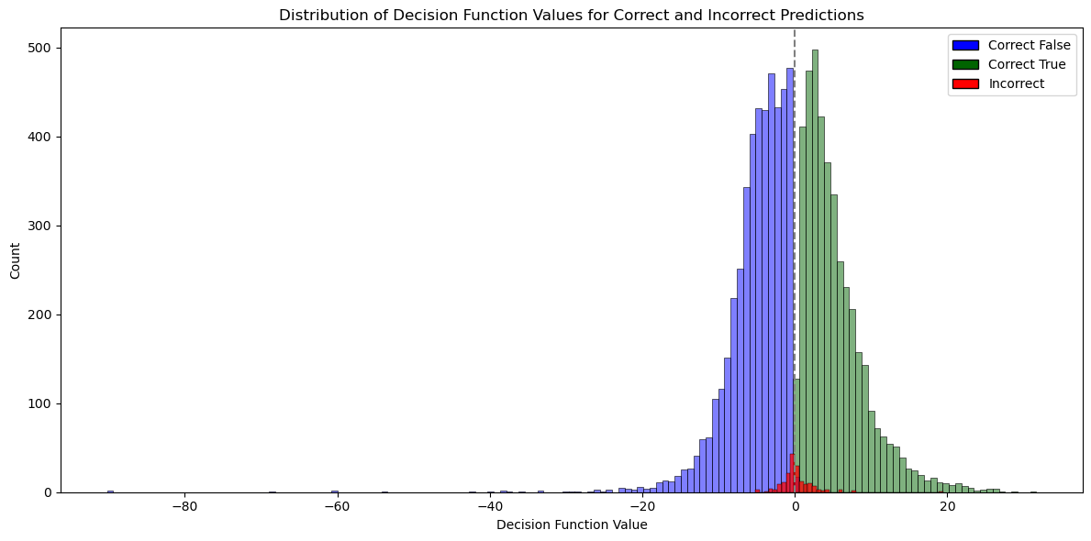
Model Interpretability
Support Vector Machine (SVM) Linear count vectorizer

Slide 20
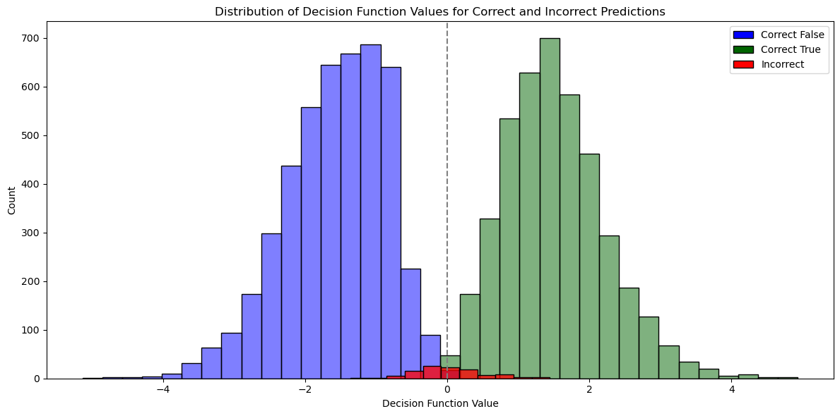
Model Interpretability
Support Vector Machine (SVM) Linear TFIDF vectorizer

Slide 21
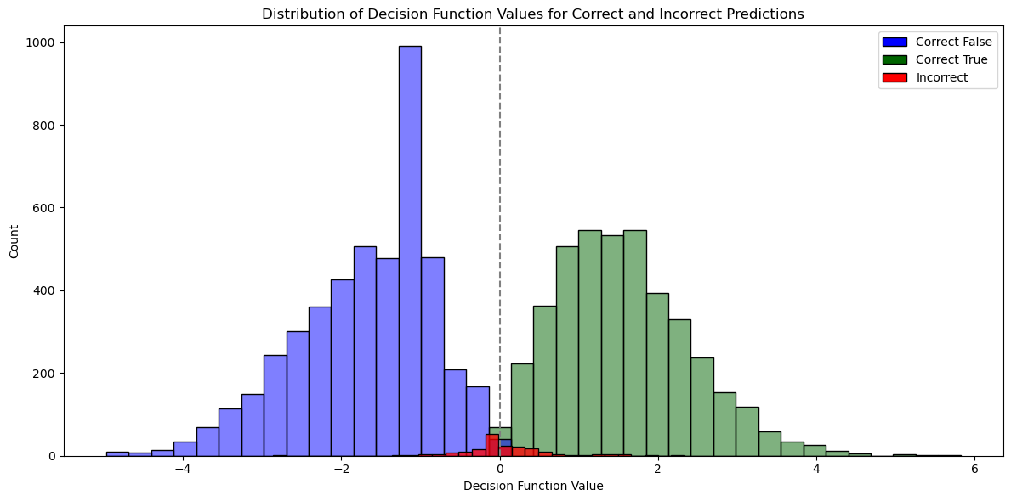
Model Interpretability
SVM count vectorizer

Slide 22
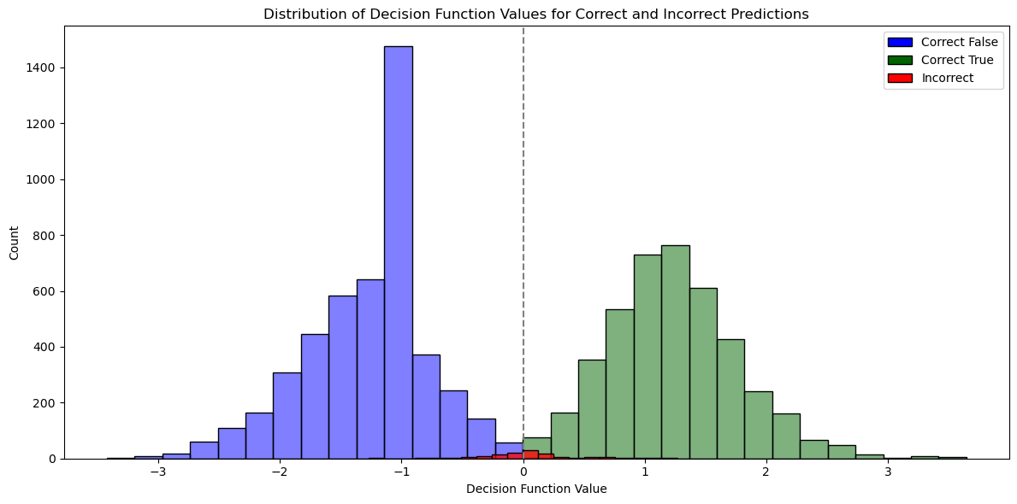
Model Interpretability
SVM TFIDF vectorizer

Slide 23
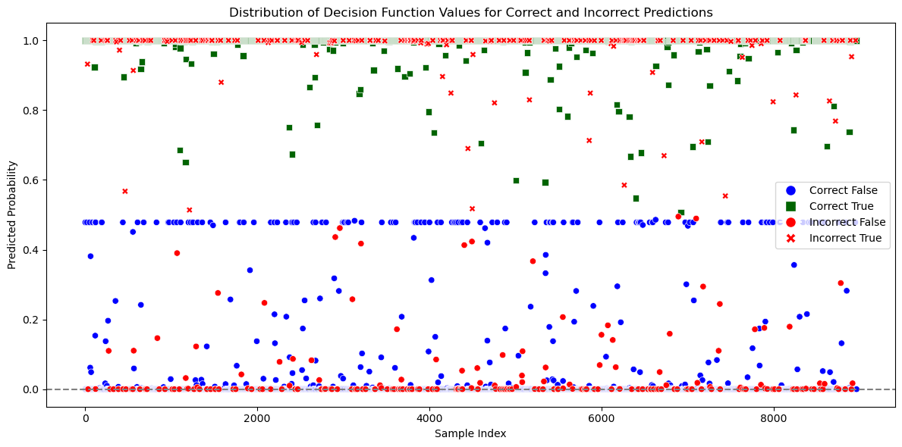
Model Interpretability
Naive Bayes count vectorizer

Slide 24
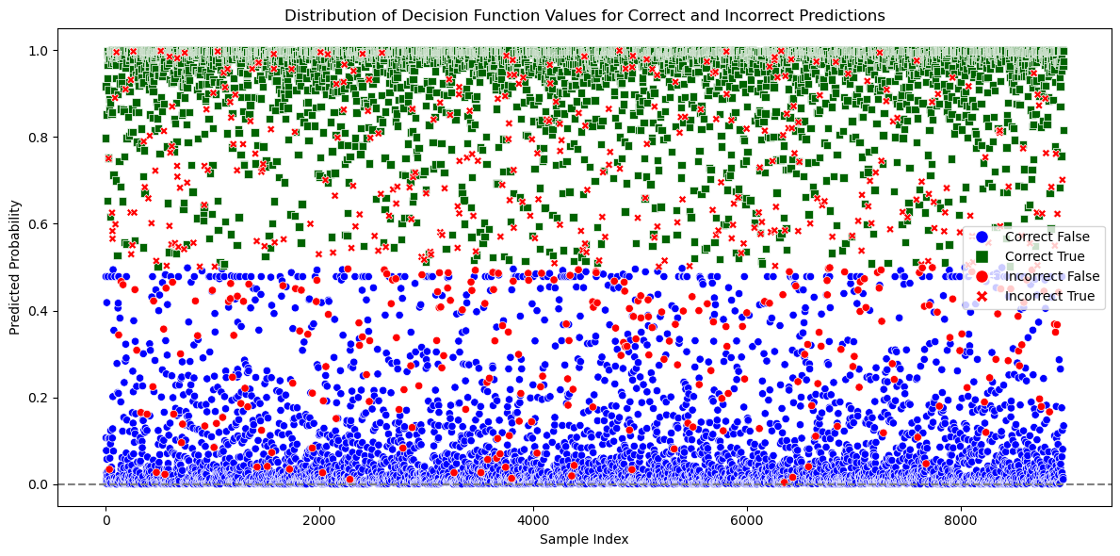
Model Interpretability
Naive Bayes TFIDF vectorizer

Slide 25
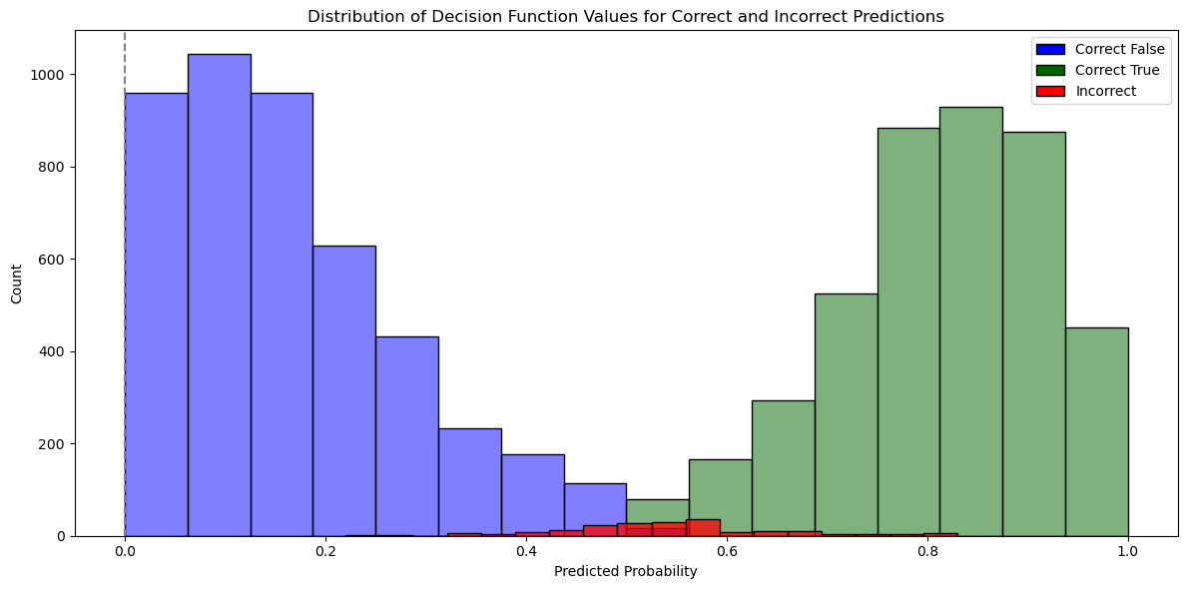
Model Interpretability
Naive Bayes count vectorizer

Slide 26
Model Interpretability
Naive Bayes TFIDF vectorizer

Slide 27
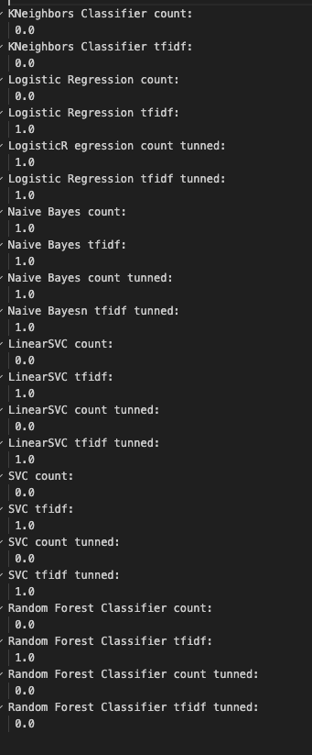

Model Interpretability

Slide 28
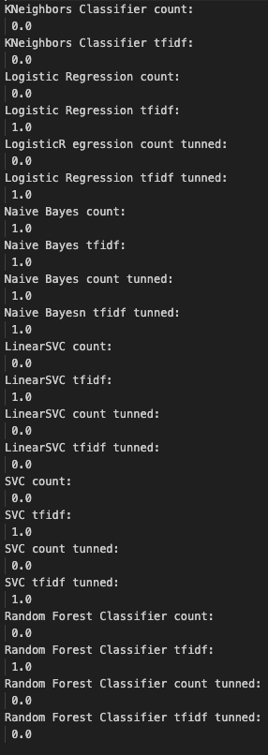

Model Interpretability

Slide 29
Future Opportunities
If you had more time, what work would you try?

